Slide 1
Medi Connect AI
Under the guidance of:
Dr. Stephen Wheeler, Ph.D
Clinical Assistant Professor
College of Information &
Ravi Varma Kumar Bevara, Ph.D
Department of Data Science.
Surya Teja Nagamalla- 11638368
Tarun Konda- 11634184
Kalyan Chakravarthy Paleti-11631405
INFO 5082:Team 16

Slide 2
Agenda
Title
Introduction
Challenges or Motivation
Related Literature Survey
Proposed Methodology
Contributions
Data Description
Model Building
Our Work
Conclusion
References

Slide 3
Introduction
Healthcare profit pools will grow at a 7% CAGR (from $583 billion in 2022 to $819 billion in 2027.)
There is a growing need of healthcare professionals.
Mediconnect AI is a specialized platform that optimizes healthcare operations using AI to reduce administrative workload and enhance patient care quality.
It offers tools like a Symptom Checker for initial patient insights and Patient Insights for summarized data to assist healthcare providers.
The platform aims to bridge gaps in healthcare services, improve decision-making, and create an efficient experience for providers and patients.

Slide 4

Challenges faced by health providers
Extensive Time on Patient Histories:
Administrative duties like reviewing and maintaining patient histories take up a large amount of a healthcare provider's workday, especially for physicians. Complicated documentation systems and regulatory obligations add to this strain.
Decreased Attention to Patient Care:
As physicians spend more time on administrative tasks, they are less available to engage directly with patients, which results in less personalized and timely care delivery.
Impact:
Healthcare professionals' mental and physical weariness is often caused by the repetitive and time-consuming nature of administrative labor. Burnout can lead to a decrease in overall care quality, more turnover, and decreased job satisfaction.

Slide 5

Challenges faced by health providers
Long Wait Times for Appointments:
The typical wait time for patients to visit a primary care physician is 26 days, while wait times for specialist care are frequently greater.
Such long wait times make it more difficult for people to receive healthcare services on time, especially if they have acute or changing symptoms.
Resulting Issues:
During the waiting period, patients might ignore or disregard their symptoms, which could result in consequences and worsening of illnesses that should have been handled sooner.
The effectiveness of therapies is reduced and overall health outcomes are impacted when illnesses, particularly chronic or serious ones, are discovered too late.

Slide 6
Related Literature Review
More recently, with the widespread adoption of electronic health record (EHR) systems, doctors are now spending approximately 6 hours of their 11-hour workdays using EHR systems and about 1.5 hours on documentation alone. With the growing shortage of primary care physicians and higher burnout rates (Shanafelt et al., 2015) ,an automatic speech recognition (ASR) technology that could accelerate transcription of clinical visits seems imminently useful.
With the model developments, Connectionist Temporal Classification (CTC) achieved word error rate(WER) of 20.1% and the LAS model (Chan et al., 2016) achieved word error rate(WER) of 18.3%.
Reference: Shanafelt, T. D., Hasan, O., Dyrbye, L. N., Sinsky, C., Satele, D., Sloan, J., & West, C. P. (2015). Changes in burnout and satisfaction with Work-Life balance in physicians and the general US working population between 2011 and 2014. Mayo Clinic Proceedings, 90(12), 1600–1613. https://doi.org/10.1016/j.mayocp.2015.08.023

Slide 7
Related Literature Review continued
While CTC and LAS models have been effective in specific speech recognition tasks, they are limited by their sensitivity to data quality and resource-intensive nature. Whisper AI offers a more robust, scalable, and efficient solution for medical transcription, particularly in real-world environments where background noise and diverse speech patterns are common. Its end-to-end design and large-scale training make it a superior choice for automatic transcription of doctor-patient conversations.
The introduction of advanced speech-to-text models, like Whisper AI, offers a possible way to streamline the transcribing procedure. These models greatly cut down on the time and effort needed for transcription by automatically converting audio recordings into text with high accuracy. Moreover, these models can translate or even transcribe speech in multiple languages and are frequently not limited to just one. Whisper AI, for instance, speaks hundreds of languages (Radford et al., n.d.). Most importantly, the goal of using AI-driven transcription is to improve the process's quality and efficiency rather than completely replace human transcribers (Bokhove & Downey, 2018).

Slide 8
Related Literature Review
Online health information access and remote consultation platforms have become more popular because of the change to a patient-centered healthcare model, particularly with the expansion of "Internet plus Healthcare." By enabling doctors to diagnose and counsel patients remotely, these platforms increase healthcare efficiency by cutting down on time spent on unnecessary chores while preserving individualized treatment (Zhou et al., 2024).
By giving rapid access to important information, improving patient care, and promoting knowledge exchange among medical experts, summarizing conversations from these remote platforms helps both patients and physicians. Using extractive or abstractive algorithms, medical dialogue summarizing facilitates the condensing of information from sources such as consultations and electronic health records into brief summaries (Chen & Lee, 2023).

Slide 9
Related Literature Review
Since early applications of AI in healthcare began in the 1980s with tools like brain biopsy trajectory mapping, the use of AI in healthcare is not totally novel(Khan & Anwar, 2019). Since then, artificial intelligence (AI) has quickly grown in the healthcare industry, and its applications today include hospital logistics, pharmaceuticals, and some medical procedures, among other things.
RAG models retrieve external data in real-time and incorporate it into the content production process, in contrast to typical LLMs that only use pre-existing training data to generate content(Toukmaji & Tee, 2024).

Slide 10
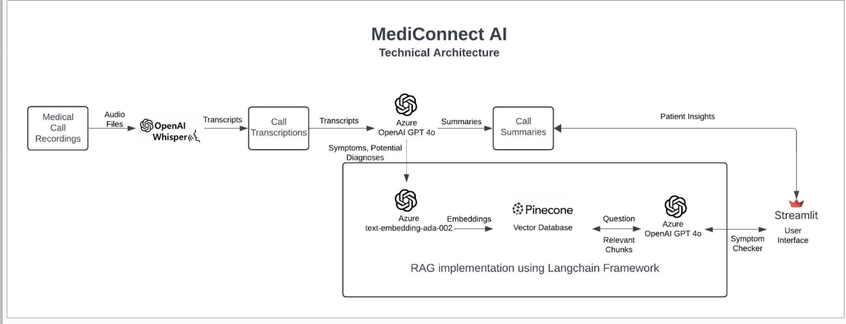
Proposed Methodology

Slide 11
Contributions:
Our team contributions and roles:
Kalyan Chakravarthy Paleti: Assisted in preparing research papers and conducting literature evaluation, ensuring findings and techniques were clearly articulated and well-supported.
Surya Teja Nagamalla: Developed the core model using GPT-4, implementing strategies for symptom evaluation, text summarization, and overall model construction and coding.
Tarun Konda:In order to make sure the chatbot system is operational, understandable, and equipped to handle real-world healthcare scenarios, this member will supervise the integration of the model into an intelligible Streamlit interface.
Overall, it’s a combined work of all of us, strived towards successful completion of project with the instructions and motivation from professor and TA’s.

Slide 12
Data Description
Format: The dataset comprises medical interviews recorded in the form of Objective Structured Clinical Examinations (OSCE).
Total Cases: 272 simulated cases between physicians and patients.
Categorization: Each case is classified into one of five categories:
Respiratory Diseases (majority of cases)
Musculoskeletal Diseases
Cardiac Diseases
Dermatological Diseases
Gastrointestinal Diseases
Data Contents: Each simulation captures interactions between the physician and the patient, focusing on various medical conditions and diagnostic assessments.
Link to our data: https://springernature.figshare.com/articles/dataset/Collection_of_simulated_medical_exams/16550013?file=30598530

Slide 13
Model Building
PHASE:1 Audio to text conversion
Used OpenAI Whisper Base Model for transcribing patient-doctor audio conversations.
Applied "text-embedding-ada-002" for embedding text data and performed cosine similarity to validate transcriptions against cleaned scripts.
PHASE:2 Text preprocessing and Summarization
Processed cleaned transcripts through GPT-40-mini for extracting key information.
Precisely promoted the model to summarize conversations into structured data.
Saved processed data into a .csv file for analysis.

Slide 14
Model Building
PHASE:3 Vector data base and Retrieval system
We have used pinecone to store and retrieve vectors and
Cosine similarity was used to improve retrieval precision.
Integrated with LLM model
To guarantee accuracy and expedite query results, vector databases and LLM were combined.
PHASE:4 Chatbot development and features
Developed an interactive interface as our end goal “mediconnect” chat bot that has features of symptom checking and patient insights of previous conversations.

Slide 15
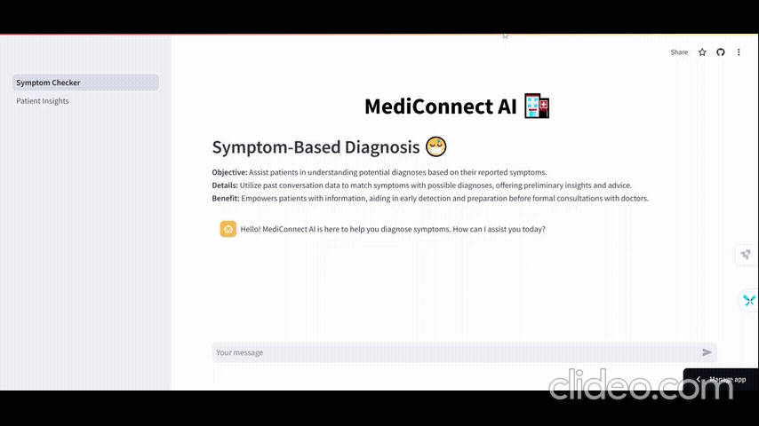
Our Work

Slide 16

Our Work

Slide 17
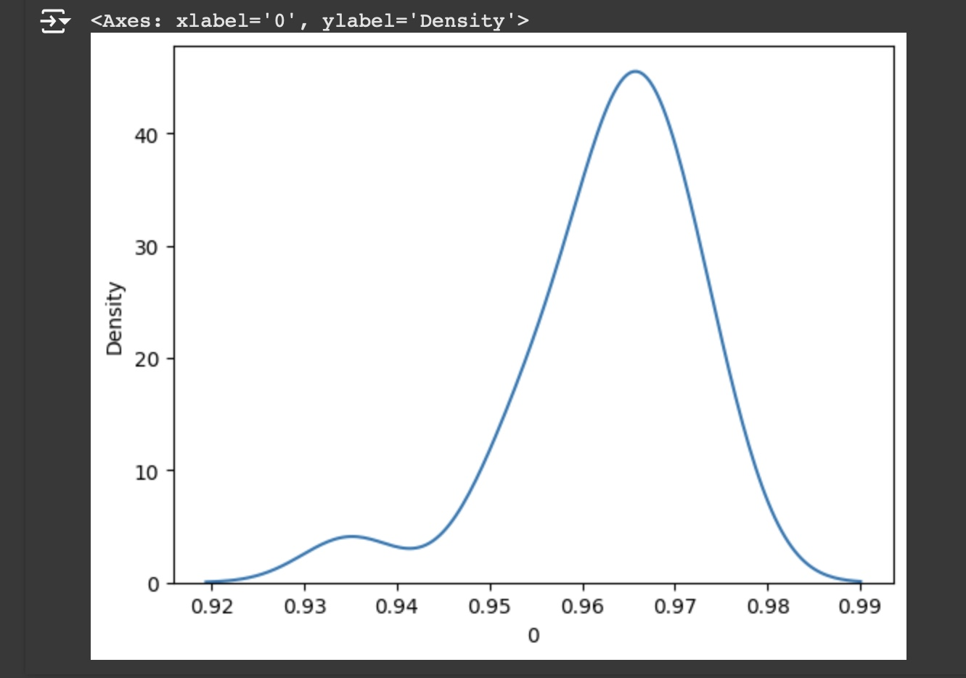
Statistical Test
Conducted one-sample t-tests to evaluate if OpenAI Whisper's transcription accuracy is significantly below 95%.
Analyzed a sample of transcribed cases to compare the accuracy against a population mean of 95%.
Calculated the t-statistic and one-tailed p-value to test the hypothesis that Whisper's performance meets or exceeds the expected accuracy.
Established a significance level (α = 0.05) to determine if the results provide sufficient evidence to reject the null hypothesis.
Result:
From the t test: We Reject the null hypothesis.
Open AI whisper transcribes audio files with an accuracy greater than 95 %.

Slide 18
Conclusion
Custom LLM Development: Improving the accuracy and stability of a tailored LLM for healthcare use cases by fine-tuning it using larger medical datasets.
Domain-Specific Information: Using medical context and words to successfully manage challenging situations.
Healthcare Integration: To speed up bigger deployments, easily connect with Electronic Health Records (EHR) and other healthcare IT systems.
Healthcare Empowerment: Using AI-driven insights to improve physician decision-making and deliver individualized treatment to patients.
Redefining Patient Care: Developing a future in which artificial intelligence (AI) transforms patient outcomes by bridging the gap between unprocessed data and workable healthcare solutions.

Slide 19
References
Chiu, C., Tripathi, A., Chou, K., Co, C., Jaitly, N., Jaunzeikare, D., Kannan, A., Nguyen, P., Sak, H., Sankar, A., Tansuwan, J., Wan, N., Wu, Y., & Zhang, X. (2018). Speech Recognition for Medical Conversations. IEEE. https://doi.org/10.21437/interspeech.2018-40
Spiller, T. R., Rabe, F., Ben-Zion, Z., Korem, N., Burrer, A., Homan, P., … Duek, O. (2023, April 27). Efficient and Accurate Transcription in Mental Health Research - A Tutorial on Using Whisper AI for Audio File Transcription. https://doi.org/10.31219/osf.io/9fue8
Liu, Y., Ju, S., & Wang, J. (2024). Exploring the potential of ChatGPT in medical dialogue summarization: a study on consistency with human preferences. BMC Medical Informatics and Decision Making, 24(1). https://doi.org/10.1186/s12911-024-02481-8

Slide 20
References
S. K. S, J. W. K. G, G. M. K. E, M. R. J, R. G. Singh A and Y. E, "A RAG-based Medical Assistant Especially for Infectious Diseases," 2024 International Conference on Inventive Computation Technologies (ICICT), Lalitpur, Nepal, 2024, pp. 1128-1133, doi: 10.1109/ICICT60155.2024.10544639.
Bora, A., & Cuayáhuitl, H. (2024). Systematic Analysis of Retrieval-Augmented Generation-Based LLMs for Medical Chatbot Applications. Machine Learning and Knowledge Extraction, 6(4), 2355–2374. https://doi.org/10.3390/make6040116

Slide 21
Thank You
Medi-connect Bot: Link

